Slide 1

Marathon – Construction Management System

Slide 2
Goals
Studying React-Native, establishing the foundation for the POC and begin developing it.
Completing the design process and finalizing the ADD.

Slide 3
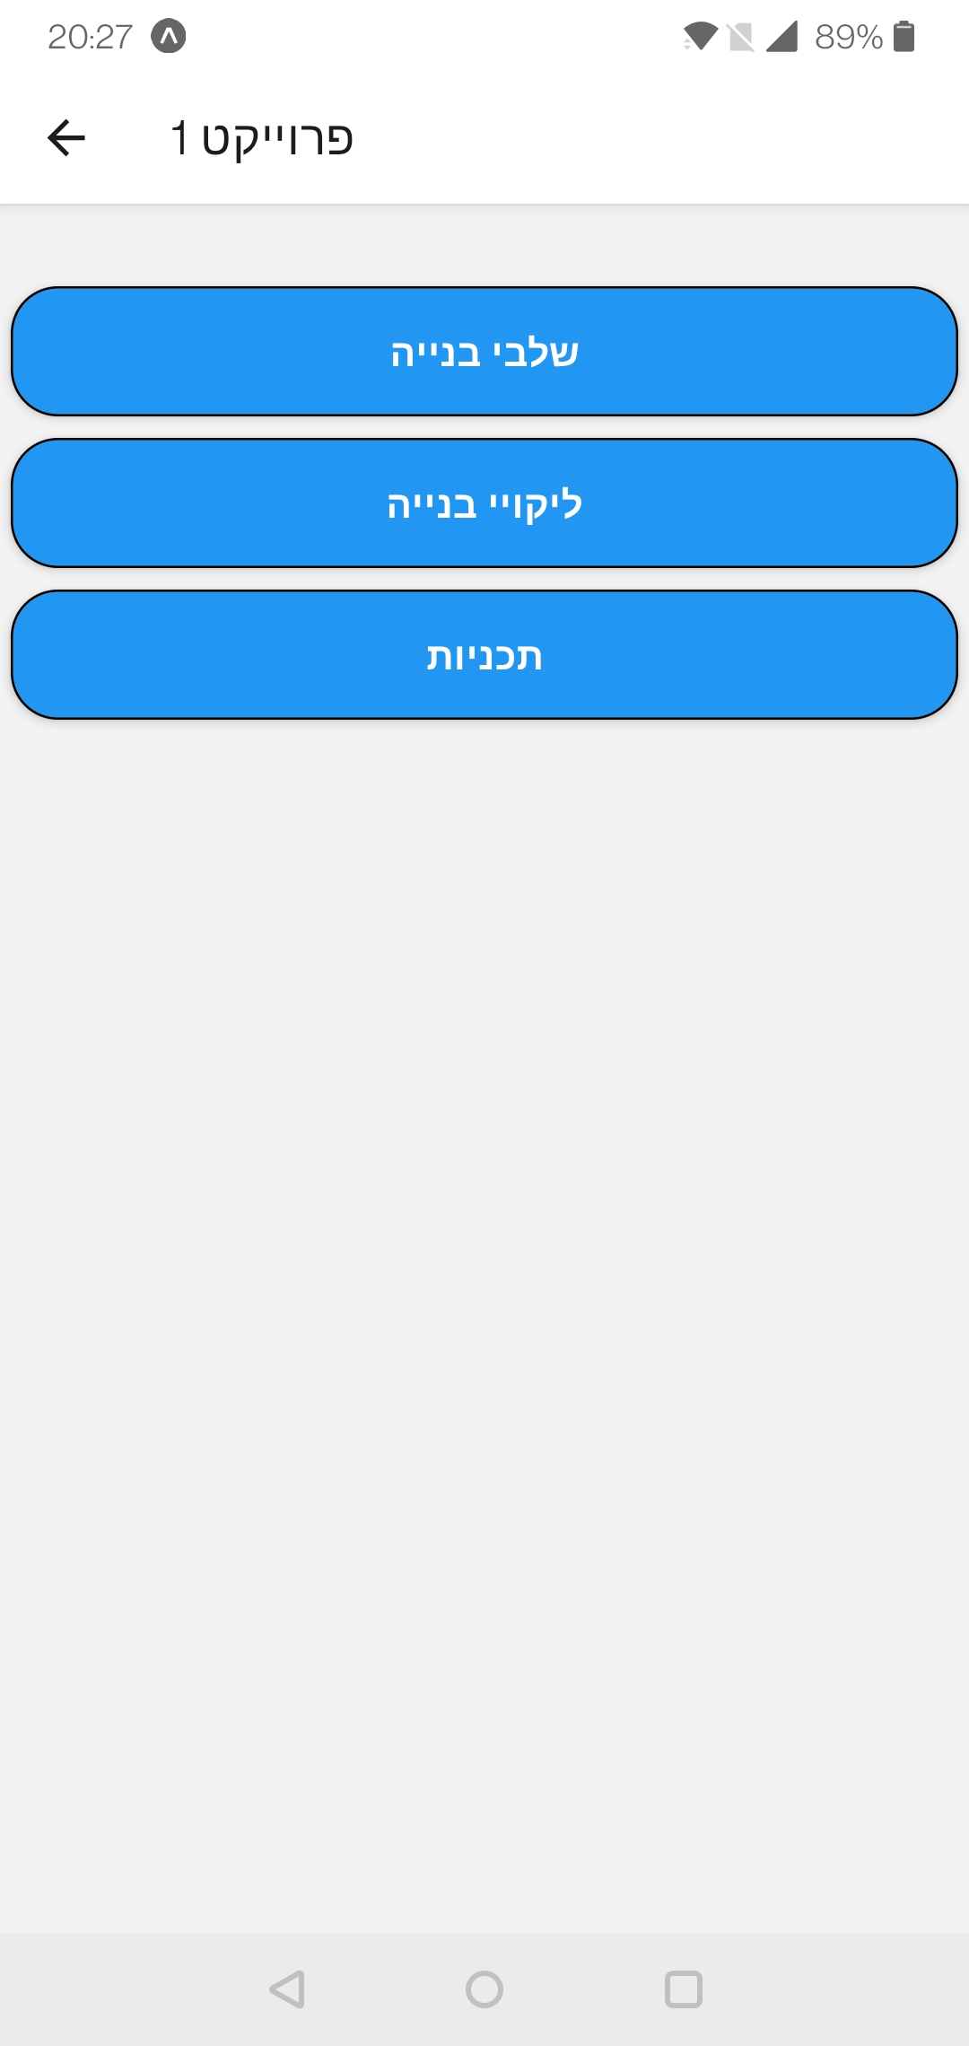
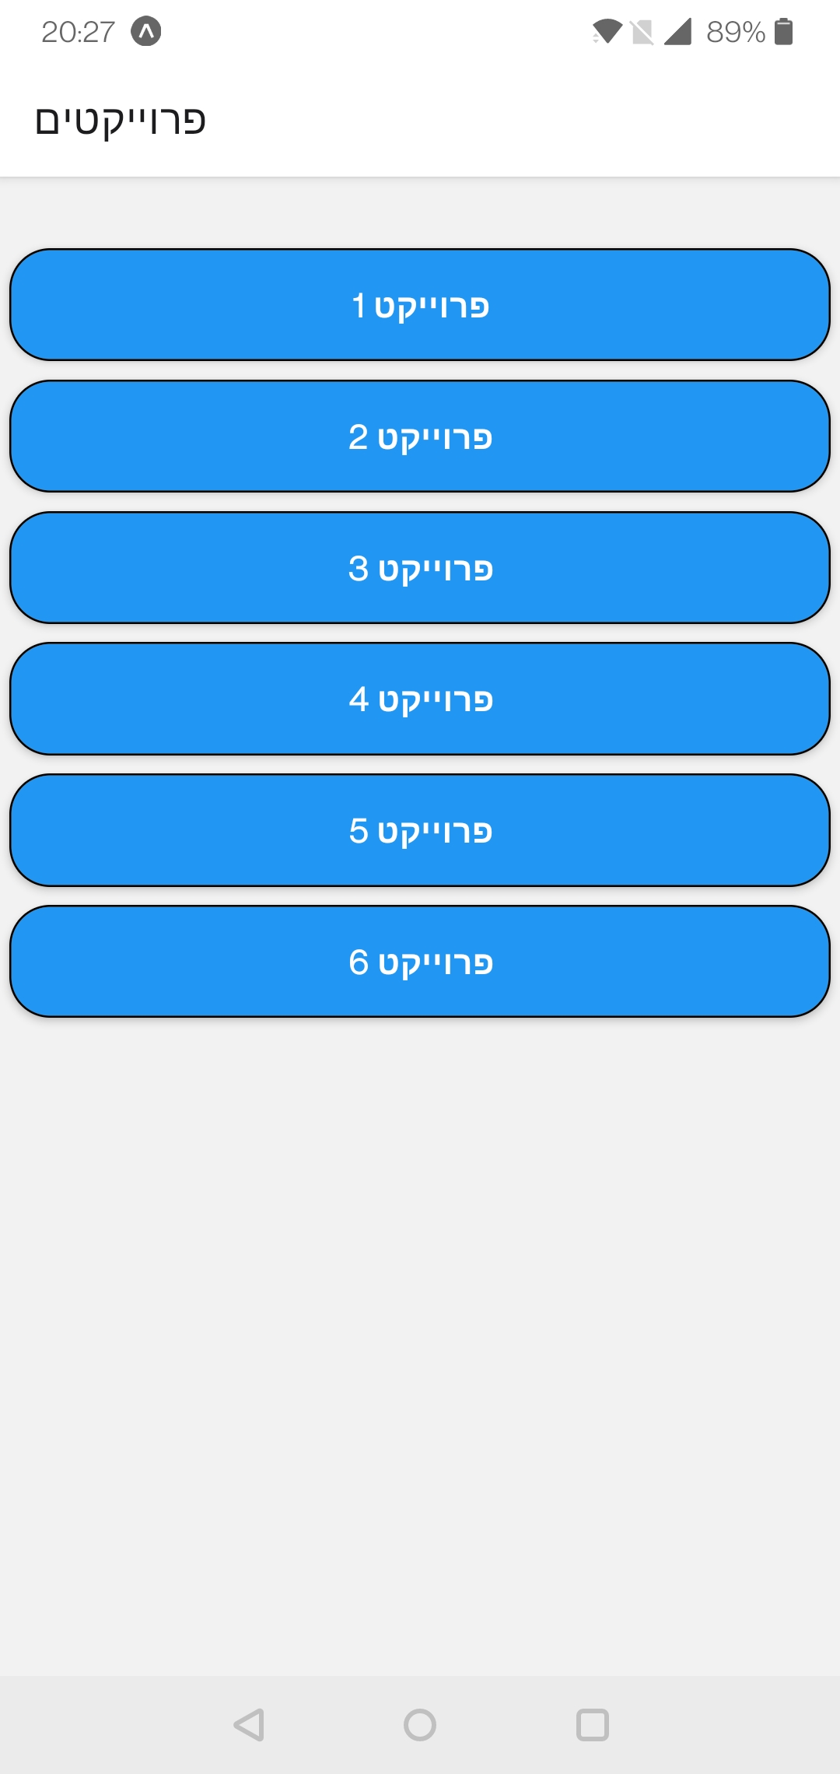
Achievements
We laid the groundwork for our project (installed packages and created directory structures).
Improved our understanding of React-Native and TypeScript.
Created some basic screens for the POC, according to our UI draft.

Slide 4

Key takeaways
Expo-go is a great platform for building, debugging and testing mobile apps.
Graphical design and useability should be our top priority, since our functionalities are rather simple.
We should consider outsourcing graphical designers.

Slide 5


Current goals
Add more screens to the POC.
Meet with our client and present the POC.
Create a user experience survey to receive feedback.
Fix ADD according to Niv’s feedback.

